Slide 1



SUMMER INTERNSHIP IN FULL STACK DEVELOPMENT AT BINARYCHAKRA
BY
NAME: YAZHINIPRIYA L,
CLASS: III CSE B,
ROLL NO:21CSE094,
REG NO:913121104124,
BATCH:2021-2025

Slide 2
Agenda
Objective
Learning
Project done
Sample code
Outcome

Slide 3

Introduction
The primary objective of the internship was to emerge with a comprehensive skill set in full-stack development that will serve as a strong foundation for my future career in the software development industry. This internship report presents my experiences and insights gained during my internship in the field of full stack development at BINARYCHAKRA TECHNOLOGIES OPC PRIVATE LTD. , during which I was involved in various aspects of designing, implementing, and deploying full stack applications.
By examining the hands-on application of front-end and back-end development tools, frameworks, and methodologies, this report aims to showcase the successful completion of assigned projects, while highlighting the growth and proficiency achieved in full-stack development.

Slide 4
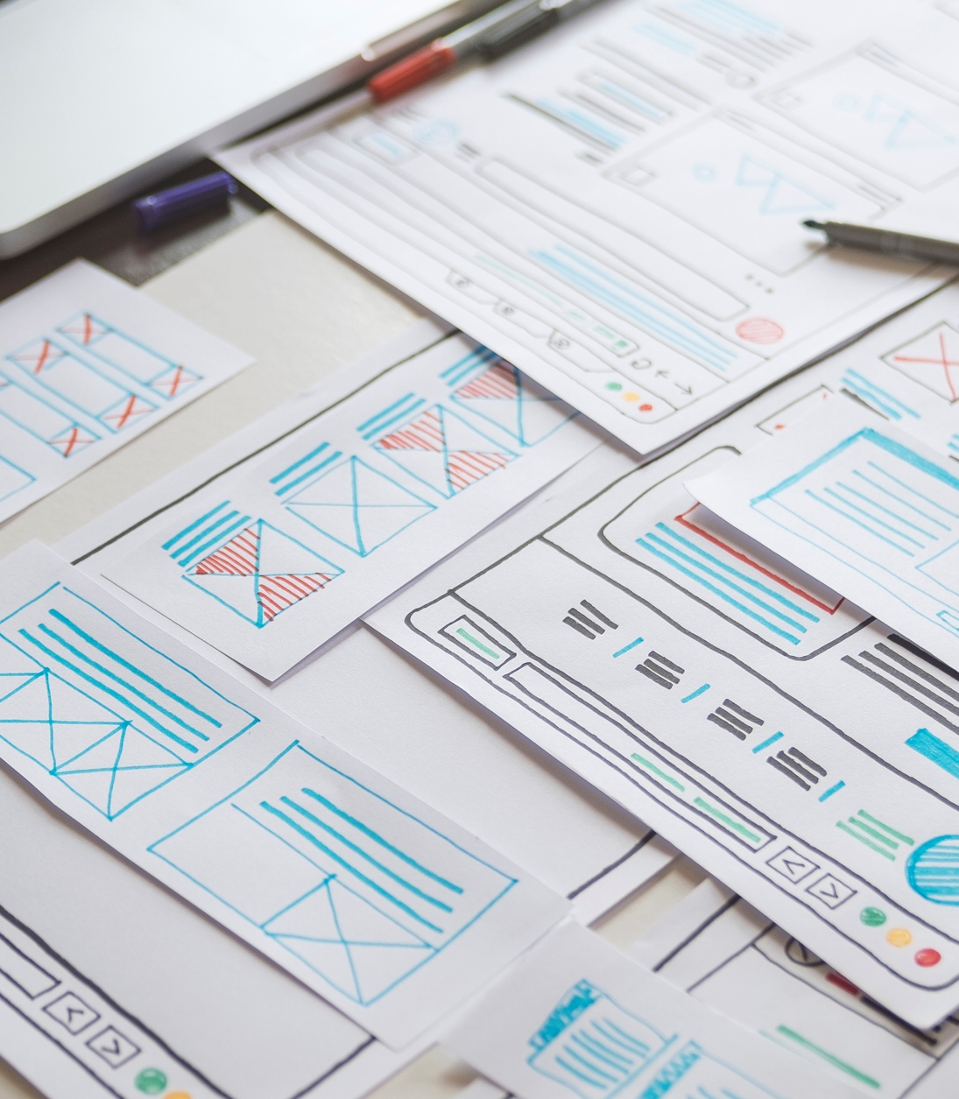
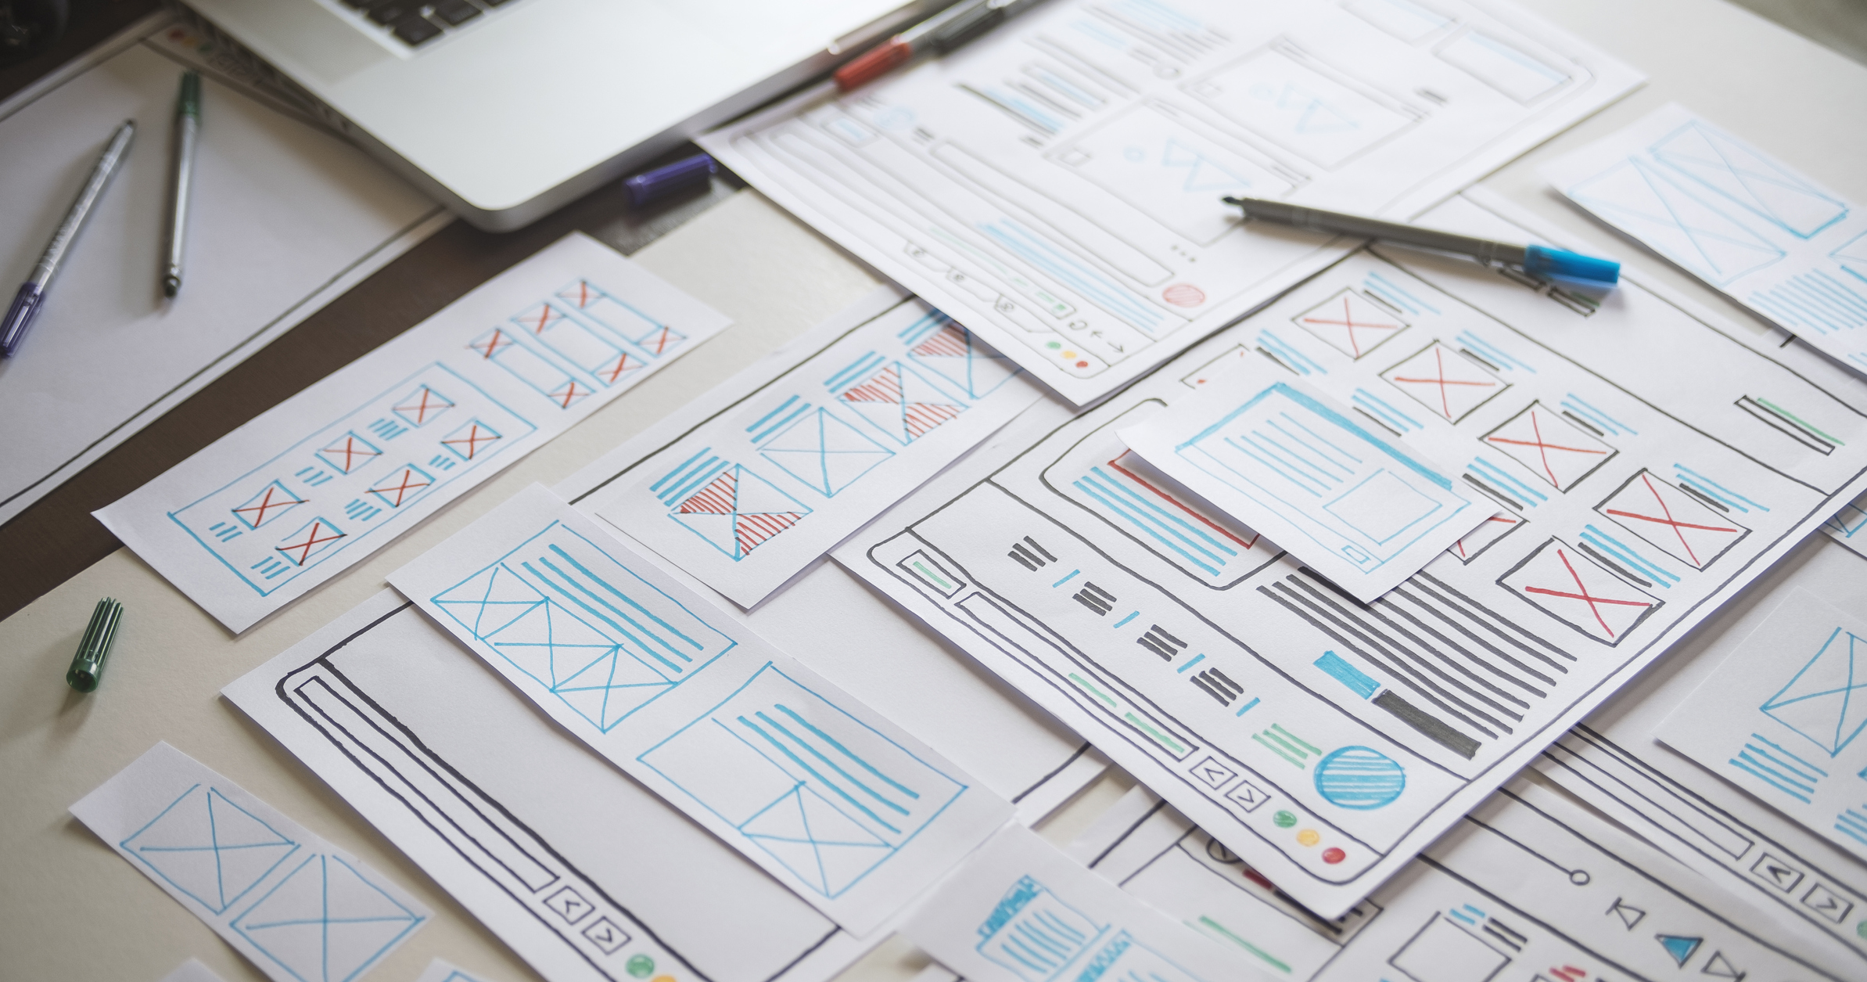
LEARNINGS
ANNUAL REVENUE GROWTH

Slide 5
FRONT-END DEVELOPMENT:
Learned about responsive design, user experience (UX) principles, and utilized frameworks like React to create dynamic and user-friendly web interfaces.
BACK-END DEVELOPMENT:
Gained insight into server-side programming using technologies such as Node.js and Flask, and understood the importance of creating APIs for communication.
DEBUGGING AND PROBLEM SOLVING:
Gained experience in identifying and resolving technical issues, debugging code, and optimizing application performance. KNOWLEDGE OF GIT: A Git repository was established as the foundation of our project. The repository housed the entire codebase, including front-end HTML, CSS, and JavaScript files, as well as back-end server scripts .It helped a lot for collaborative works.

Slide 6
Plan for product development
SETTING UP REACT
DESIGINING THE LAYOUT
DESIGNING THE METRICS
LOGICAL CALCULATION FUNCTION
RESETTING THE METRICS

Slide 7
Project: Tokenization tool
Description: Implementing tokenization, breaking down the template into individual tokens representing text and placeholders.
Project : Blood donation App Development
Description : Serves as a vital tool in connecting donors with hospitals, blood banks, and those facing medical emergencies requiring blood transfusions. By leveraging modern technology and a user-centric approach, the Blood Donation App aims to streamline the blood donation process, increase awareness, and save lives.

Slide 8
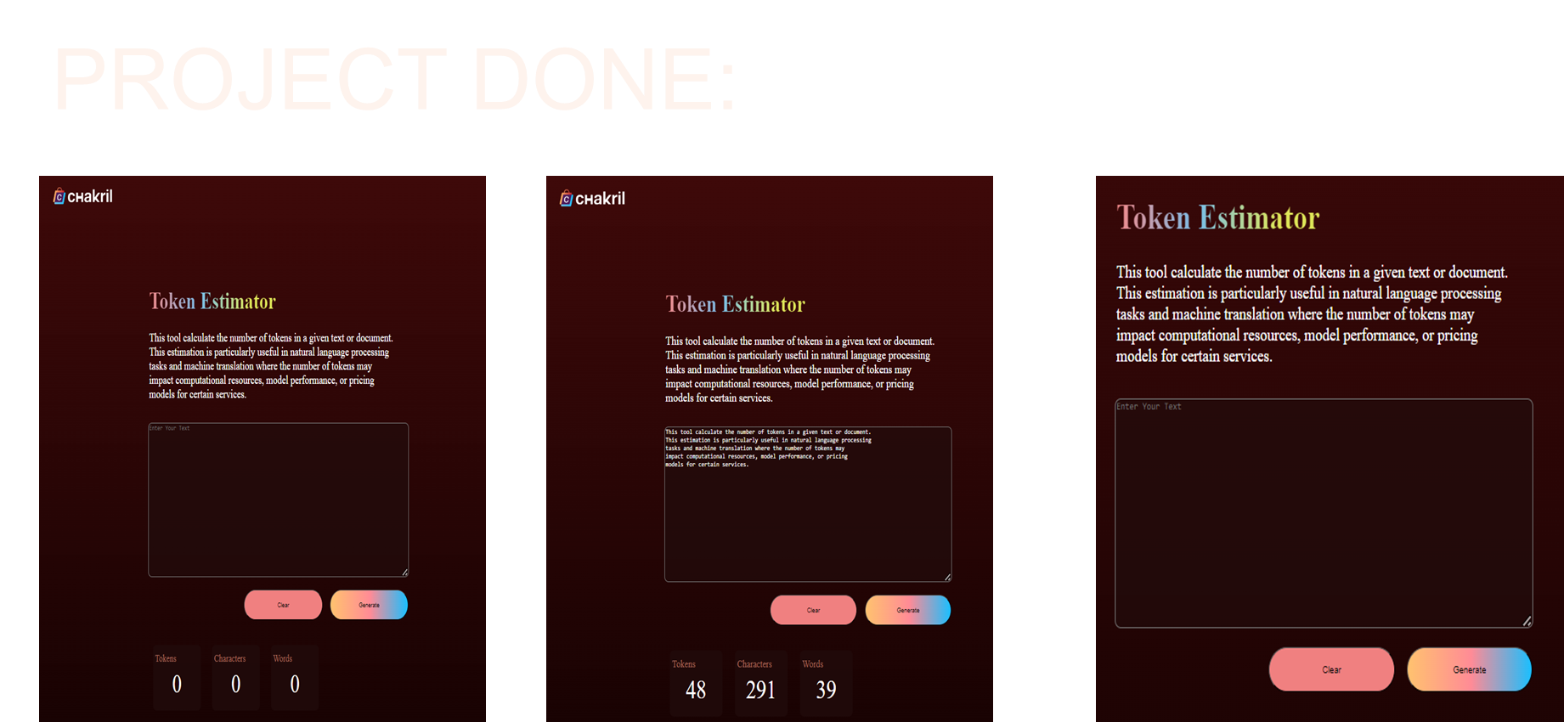
8

Slide 9
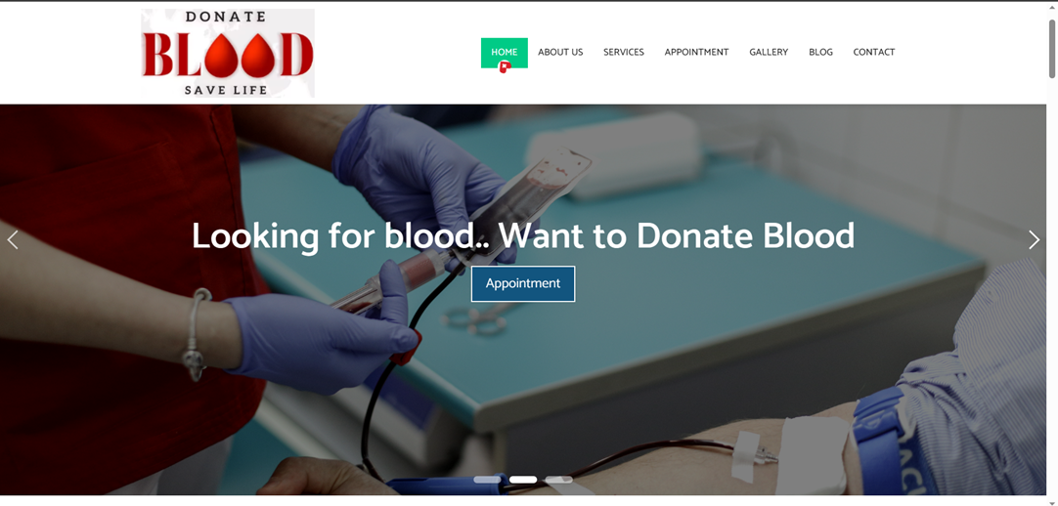
Website creation
9

Slide 10
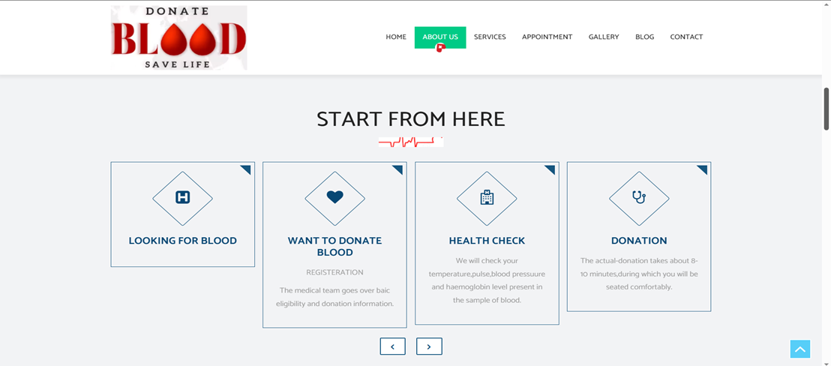

Slide 11
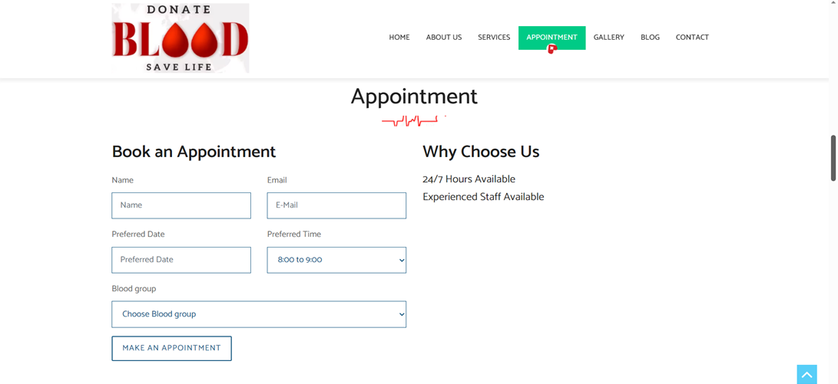
11

Slide 12
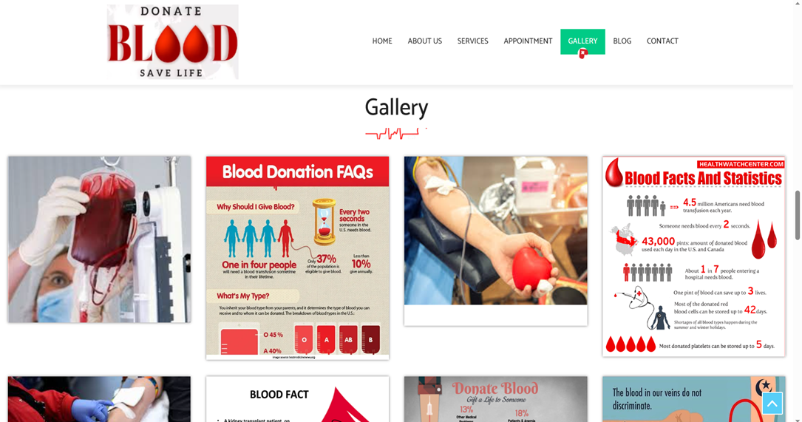

Slide 13
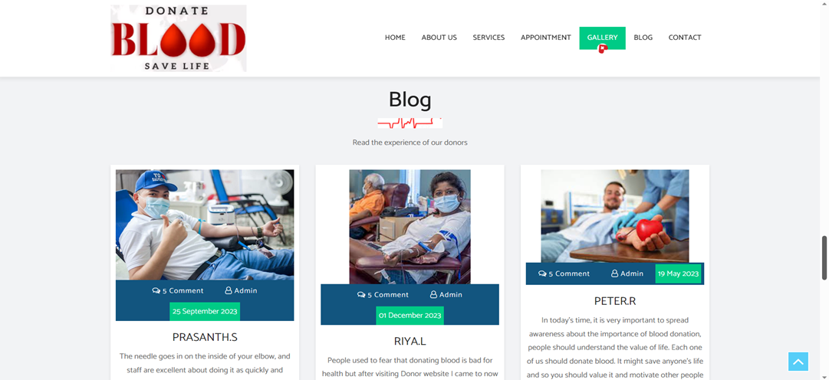
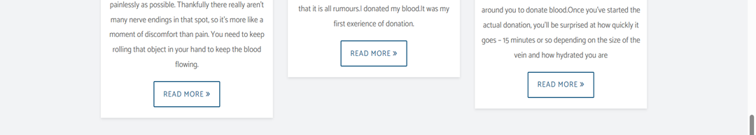
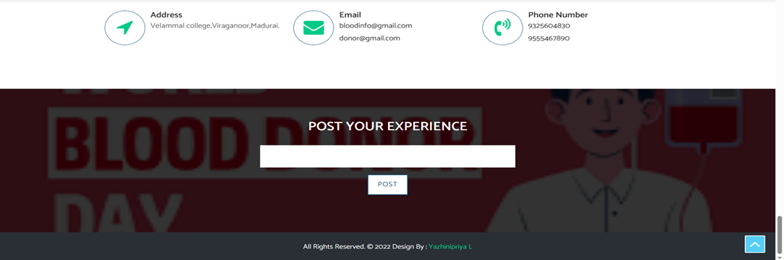
13

Slide 14

SAMPLE CODE: Token estimator: import {useState} from 'react'
import './App.css';
import chakra from './chakra.png';
function App() {
const [text, settext] = useState('');
const [CharCount, setCharCount] = useState(0);
const [WordCount, setWordCount] = useState(0);
const [TokenCount, setTokenCount] = useState(0);
const handleChange = (e) => {
settext(e.target.value);
};
const counter = () => {
setCharCount(text.length);
setWordCount(text.split(" ").length);
setTokenCount(countTokens(text));
};
const countTokens = (text) => {
const tokens = text.split(" ");
let tokenCount = 0;
for (let i = 0; i < tokens.length; i++) {
if (tokens[i].length > 4) {
tokenCount += 2;
}
else if(tokens[i].length < 2){
tokenCount += 0;
}
}
return tokenCount;
};
const clearTextarea = () => {
settext('');
};

Slide 15
return (
<>
<div className="img">
<img src={chakra} alt="My Logo" style={{ width: '100px', height: '50px',width:'180px' }} />
</div>
<div className="text">
<h1 class="h1">
Token Estimator
</h1>
<div className="editor">
<div>
This tool calculates the number of tokens in a given text or document.
</div>
<div>
This estimation is particularly useful in natural language processing </div>
<div> tasks,such as language modeling, machine translation, and text </div>
<div> generation, where the number of tokens may impact computational</div>
<div> resources, model performance,or pricing models for certain services.</div>
</div>
<br></br>
<textarea className="textarea" placeholder='Enter Your Text' value={text} onChange={(e) => settext(e.target.value)} >
</textarea>
</div>
<div className = 'buttons'>
<button className='button2' onClick={clearTextarea}>Clear</button>
<button className='button1' onClick={counter}>Generate</button> </div>
<div className="align">
<div className="rectangle">
<div className="content">
<h2>Tokens</h2>
<p>{TokenCount}</p></div></div>
<div className="rectangle" >
<div className="content">
<h2>Characters</h2>
<p>{CharCount}</p></div></div>
<div className="rectangle">
<div className="content">
<h2>Words</h2>
<p>{WordCount}</p></div></div></div></>)
};
export default App;

Slide 16
BLOOD DONATING WEBSITE: <!DOCTYPE html>
<html lang="en">
<head>
<link rel="shortcut icon" href="images/favicon.ico" type="image/x-icon">
<link rel="apple-touch-icon" href="images/apple-touch-icon.png">
<!-- Bootstrap CSS -->
<link rel="stylesheet" href="css/bootstrap.min.css">
<link rel="stylesheet" href="css/pogo-slider.min.css">
<link rel="stylesheet" href="css/style.css">
<link rel="stylesheet" href="css/responsive.css">
<link rel="stylesheet" href="css/custom.css">
</head>
<body id="home" data-spy="scroll" data-target="#navbar-wd" data-offset="98">
<div id="preloader">
<div class="loader">
<img src="images/preloader.gif" alt="" />
</div>
</div>end loader -->
<div class="main-top">
<div class="container">
<div class="row">
<div class="col-lg-6">
<div class="left-top">
<a class="new-btn-d br-2" href="#"><span>Book Appointment</span></a>
<div class="mail-b"><a href="#"><i class="fa fa-envelope-o" aria-hidden="true"></i> donar@gmail.com</a></div>
</div></div>
<div class="col-lg-6">
<div class="wel-nots">
</div>
<div class="right-top">
<ul>
<li><a href="#"><i class="fa fa-facebook" aria-hidden="true"></i></a></li>
<li><a href="#"><i class="fa fa-twitter" aria-hidden="true"></i></a></li>
<li><a href="#"><i class="fa fa-instagram" aria-hidden="true"></i></a></li>
<li><a href="#"><i class="fa fa-youtube-play" aria-hidden="true"></i></a></li>
</ul>
</div>

Slide 17

Outcome My internship at Binarychakra provided an opportunity to immerse in real-world software development, working on both front-end and back-end components of web applications. Understood the importance of responsive and user-centric design principles in web development.Learnt about API integration and data manipulation for seamless communication between front-end and back-end.Gained exposure to modern web development frameworks and technologies.

Slide 18


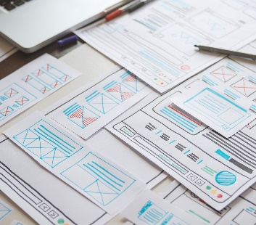
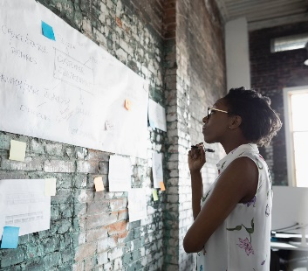
QUERIES

Slide 19
THANK YOU!

